Slide 1
Intelligent Information Retrieval
Week 10 – The Concept of Automatic Summarization

Slide 2
Introduction
Automatic summarization is a shortened version of a text using a computer program whose results still have important information in the form of basic ideas and words or sentences that can represent the entire original text. (Manuel and Moreno, 2014).
Purpose: to create short, accurate, fast time summaries, easy to understand sentences and still have important information to convey from the original text.

Slide 3
General Methods
Extractive Method is a method that takes words or sentences from the original text, where the summary does not change words or sentences in the text.
Abstractive Method is a method that gives new words that are not in the original text, then combines and arranges the new words with original words to create new sentences in the summary.

Slide 4
Extractive Method
The extractive method is divided into several kinds of methods, such as: semantic analysis approach, fuzzy logic, swarm intelligence, and statistical approach.
Focus in this meeting: Statistical approach

Slide 5
Statistical approach
A method that takes certain words or sentences in a text, where certain sentences are obtained from sentences that have a high similarity score compared to other sentences, while certain words are obtained from words that have the highest weight. Then these words and sentences will be combined into a summary without any change in words from the original text.
There are 5 methods included in the statistical approach, namely the title method, location method, aggregation similarity method, frequency method, and tf-based query method.

Slide 6
Title Method
The title method is only used if the original text has a title. The sentence score is calculated from how many equal words are used between the sentence and the title. This calculation is done with the similarity between the sentence and the title.
The title method is needed because usually the title already has the main information that you want to convey in the text.

Slide 7
Tf Based Query Method
This method is used when a text does not have a title. In this method, words that have a high appearance value (tf raw) will be taken in the original text, then the selected words will be considered as the title of the text and each sentence in the text will be calculated for their similarity as in the title method.

Slide 8
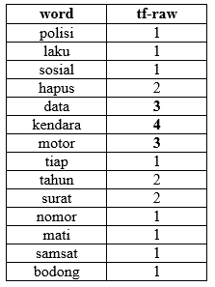
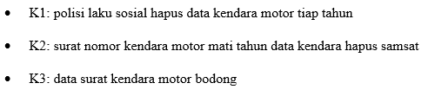
Tf Based Query Method

Slide 9

Location Method
The location method is given a score for each sentence against its location in a text. Usually, the sentence at the beginning of the text is more important and can be a good summary, so that it has a higher initial sentence score.

Slide 10
Frequency Method
The frequency method calculates the weight score of a sentence.
The score is calculated from the total weight of each word that a sentence has.
The weight of each word for each sentence is obtained from the calculation of tf-idf.

Slide 11

Aggregation Similarity Method
In the aggregation similarity method, the sentence score is calculated from the total similarity of a sentence with all other sentences in the text.

Slide 12
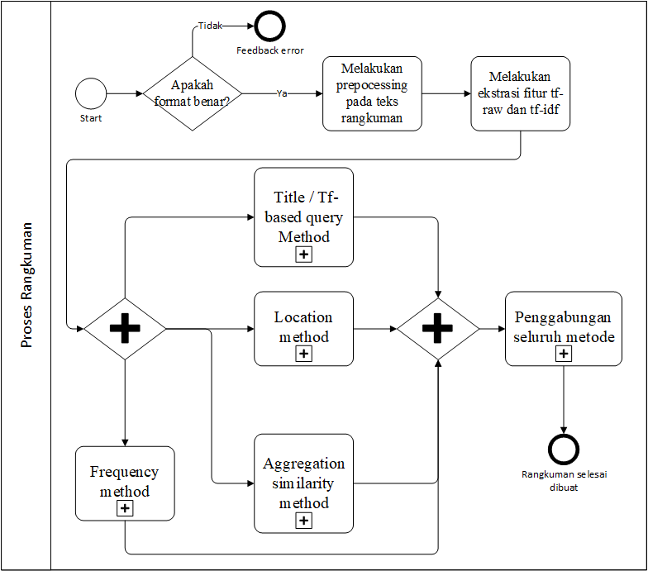
Detail Process

Slide 13
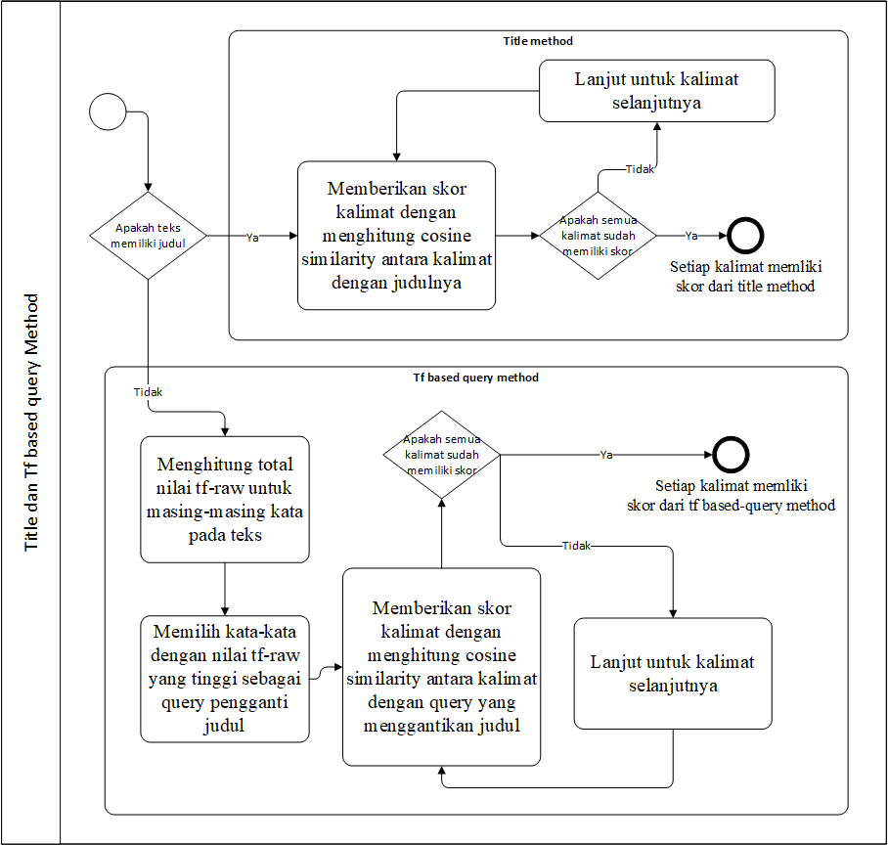
Title/Tf-based Query Method

Slide 14
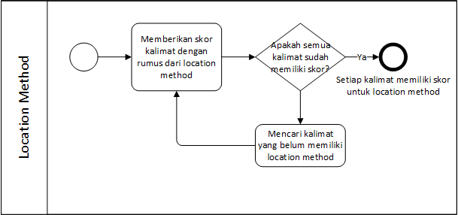
Location method Process

Slide 15
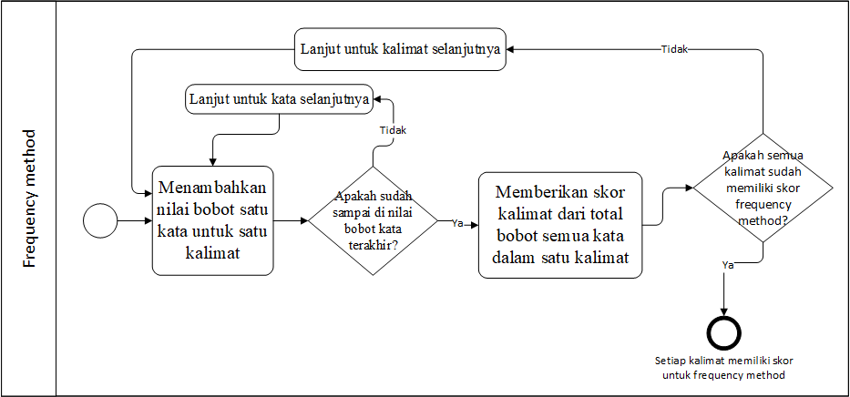
Frequency method Process

Slide 16
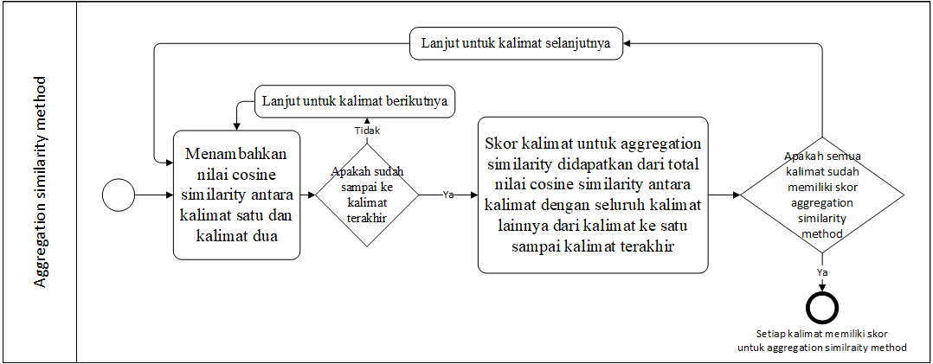
Aggregation Similarity method Process

Slide 17
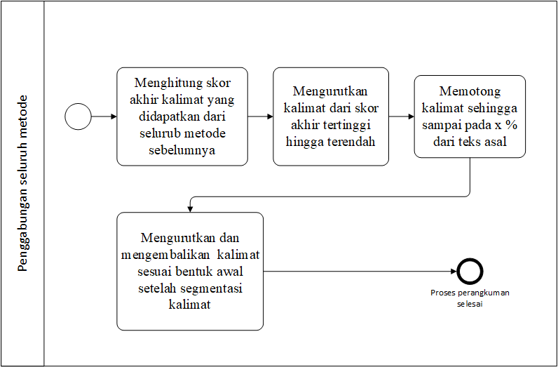

Combining All Methods

Slide 18
Questions???

Slide 19
Exercise
Look for 2 scientific articles on the implementation of the Abstractive Method for automatic summarization.
Make a summary of the 2 articles in the file format: NRP_Nickname_AM.pdf.
Do not forget to write down the source of reference.
Upload in ULS before the deadline.

